Slide 1
Operating Systems (Disk Management)
Presented By Sudeshna Kundu (Mondal)

Slide 2
Moving-head Disk Mechanism

Slide 3
Basic Terminologies
Access time has two major components –
Seek time: Time taken by R/W head to reach to desired track.
Rotation Time: Time taken for one full rotation
Rotational latency: Time taken to reach to desired sector (1/2* rotation time)
Transfer Time: Data to be transfer/ transfer rate
[Transfer rate: no. of heads* capacity of one track*no. of rotations in one second]
Disk Access Time = Seek Time + Rotational Latency + Transfer Time

Slide 4
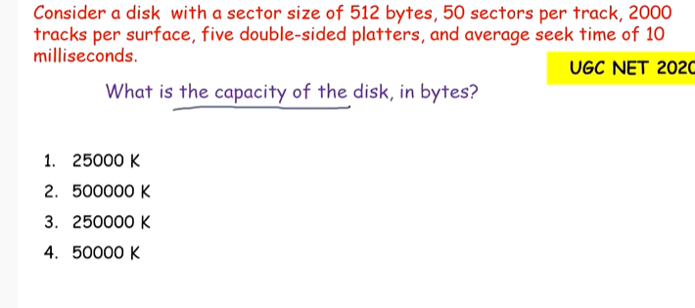
Problems

Slide 5
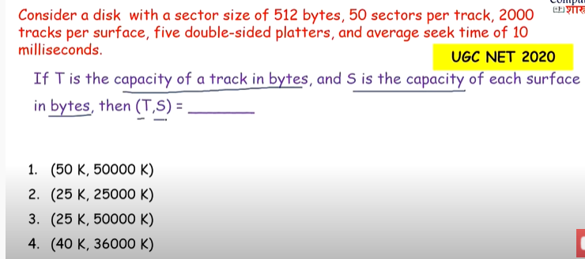

Slide 6
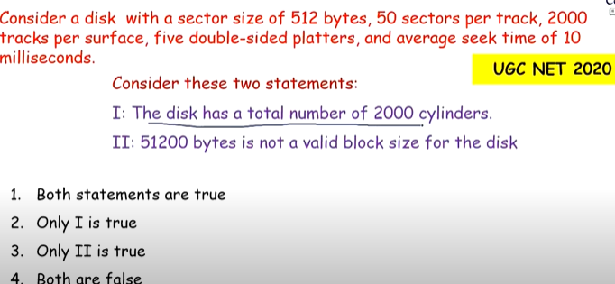

Slide 7


Slide 8
Disk Scheduling (Cont.)
Note that drive controllers have small buffers and can manage a queue of I/O requests (of varying “depth”)
Several algorithms exist to schedule the servicing of disk I/O requests
The analysis is true for one or many platters
We illustrate scheduling algorithms with a request queue (0-199)
98, 183, 37, 122, 14, 124, 65, 67
Head pointer 53

Slide 9
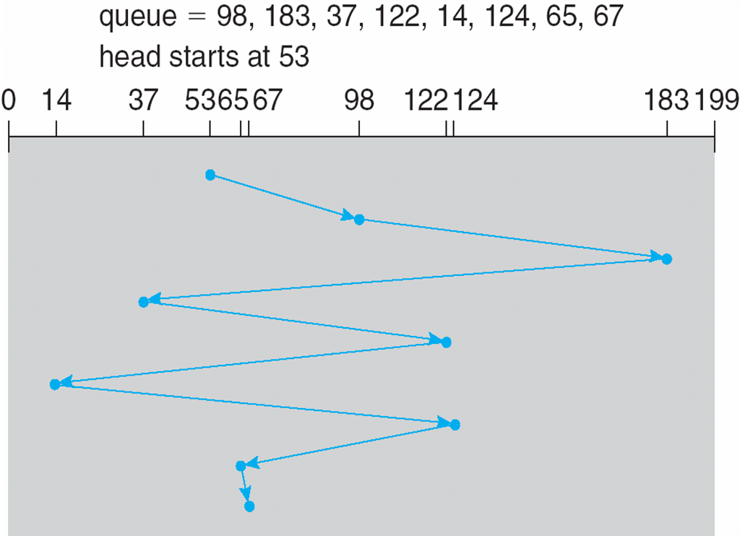
FCFS
Illustration shows total head movement of 640 cylinders

Slide 10
FCFS
Advantages:
It is the simplest Disk Scheduling algorithm.
It services the IO requests in the order in which they arrive. There is no starvation in this algorithm, every request is serviced.
Can be used with less load
Disadvantages
The scheme does not optimize the seek time.
The request may come from different processes therefore there is the possibility of inappropriate movement of the head.

Slide 11
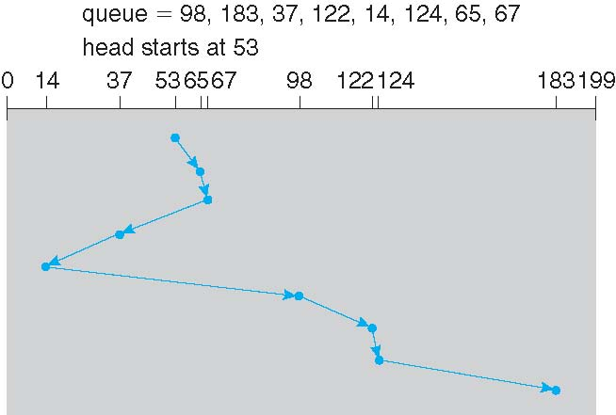
SSTF
Shortest Seek Time First selects the request with the minimum seek time from the current head position
SSTF scheduling is a form of SJF scheduling; may cause starvation of some requests
Illustration shows total head movement of 236 cylinders

Slide 12
SSTF
Advantages
Very efficient in seek moves
Less average response time and waiting time
Increased throughput
Disadvantages
It may cause starvation for some requests.
Switching direction on the frequent basis slows the working of algorithm.
It is not the most optimal algorithm.

Slide 13
SCAN
The disk arm starts at one end of the disk, and moves toward the other end, servicing requests until it gets to the other end of the disk, where the head movement is reversed and servicing continues.
SCAN algorithm Sometimes called the elevator algorithm
Illustration shows total head movement of 236 cylinders
But note that if requests are uniformly dense, largest density at other end of disk and those wait the longest

Slide 14
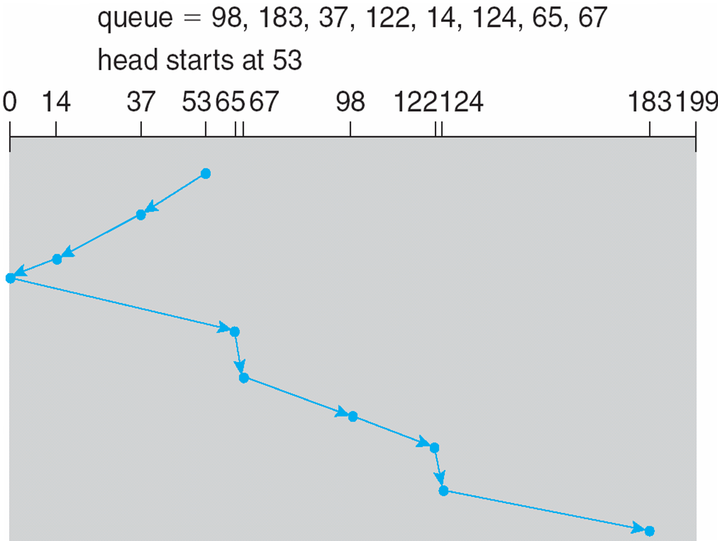
SCAN (Cont.)

Slide 15
SCAN (Cont.)
Advantages
Simple easy to understand and implement
No starvation (bounded waiting)
Low variance and average waiting time
Disadvantages
Long waiting time for location visited by head
Unnecessary move till the end of the disk, even if there is no request

Slide 16
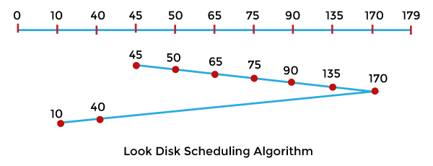
LOOK
It is the more advanced version of the SCAN disk scheduling algorithm. In this algorithm, the head begins at one end of the disk and works its way to the other end, and serving all requests along the way. When the head reaches the end of one end's last request, it changes direction and returns to the first request, servicing all requests in between. Unlike SCAN, instead of going to the last track, this head goes to the last request and then changes direction.
Example:
Let's take an example to understand the LOOK Disk Scheduling Algorithm. Let's take a disk with 180 tracks (0-179) and the disk queue having input/output requests in the following order: 75, 90, 40, 135, 50, 170, 65, 10. The initial head position of the Read/Write head is 45 and would move on the right-hand side. Find the total number of track movements of the Read/Write head using the LOOK disk scheduling algorithm

Slide 17
C-SCAN
Provides a more uniform wait time than SCAN
The head moves from one end of the disk to the other, servicing requests as it goes
When it reaches the other end, however, it immediately returns to the beginning of the disk, without servicing any requests on the return trip
Treats the cylinders as a circular list that wraps around from the last cylinder to the first one
Total number of cylinders?

Slide 18
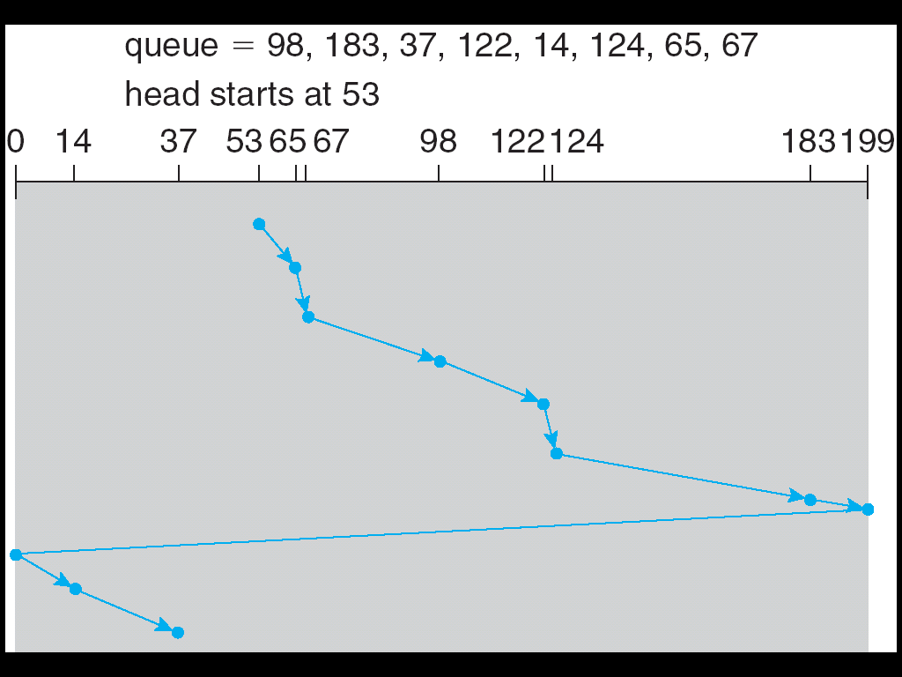
C-SCAN (Cont.)

Slide 19
C-SCAN (Cont.)
Advantages
Provides uniform waiting time
better average response time
Disadvantages
More seek movements compared to simple SCAN.

Slide 20
C-LOOK
LOOK a version of SCAN, C-LOOK a version of C-SCAN
Arm only goes as far as the last request in each direction, then reverses direction immediately, without first going all the way to the end of the disk
Total number of cylinders?

Slide 21
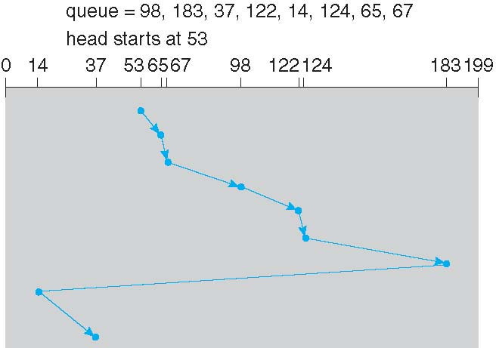
C-LOOK (Cont.)

Slide 22
C-LOOK (Cont.)
Advantages
More uniform waiting time compared to LOOK
More efficient (less moves) compared to C-SCAN
Disadvantages
More overhead in calculations
Should not be used in case of more load

Slide 23
Problems:
1. Suppose the following disk request sequence (track numbers) for a disk with 100 tracks is given: 45, 20, 90, 10, 50, 60, 80, 25, 70. Assume that the initial position of the R/W head is on track 50. The additional distance that will be traversed by the R/W head when the Shortest Seek Time First (SSTF) algorithm is used compared to the SCAN (Elevator) algorithm (assuming that SCAN algorithm moves towards 100 when it starts execution) is _________ tracks [GATE 2015] (A) 8 (B) 9 (C) 10 (D) 11
Ans. 10

Slide 24
Given a disk with 100 tracks
And Sequence 45, 20, 90, 10, 50, 60, 80, 25, 70.
Initial position of the R/W head is on track 50.
In SSTF, requests are served as following
Next Served Distance Traveled
50 0
45 5
60 15
70 10
80 10
90 10
25 65
20 5
10 10
-----------------------------------
Total Dist = 130
If Simple SCAN is used, requests are served as following
Next Served Distance Traveled
50 0
60 10
70 10
80 10
90 10
45 65
25 20
20 5
10 10
-----------------------------------
Total Dist = 140
Less Distance traveled in SSTF = 130 - 140 = 10

Slide 25
Problems:
2. Suppose a disk has 201 cylinders, numbered from 0 to 200. At some time the disk arm is at cylinder 100, and there is a queue of disk access requests for cylinders 30, 85, 90, 100, 105, 110, 135 and 145. If Shortest-Seek Time First (SSTF) is being used for scheduling the disk access, the request for cylinder 90 is serviced after servicing ____________ number of requests. (GATE CS 2014 ) (A) 1 (B) 2 (C) 3 (D) 4
Ans. C

Slide 26
Selecting a Disk-Scheduling Algorithm
SSTF is common and has a natural appeal
SCAN and C-SCAN perform better for systems that place a heavy load on the disk
Less starvation
Performance depends on the number and types of requests
Requests for disk service can be influenced by the file-allocation method
And metadata layout
The disk-scheduling algorithm should be written as a separate module of the operating system, allowing it to be replaced with a different algorithm if necessary
Either SSTF or LOOK is a reasonable choice for the default algorithm
What about rotational latency?
Difficult for OS to calculate
How does disk-based queueing effect OS queue ordering efforts?

Slide 27
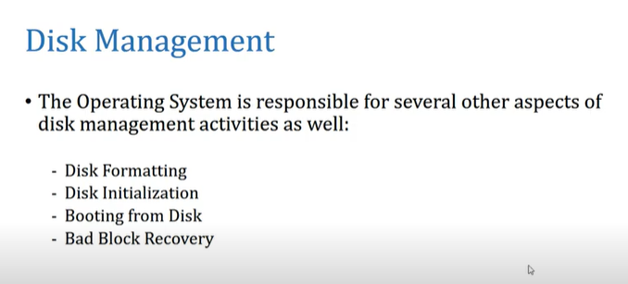

Slide 28
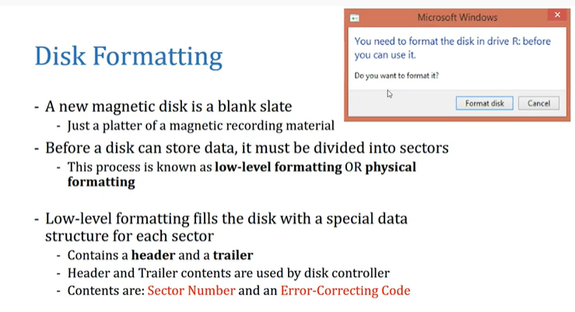

Slide 29
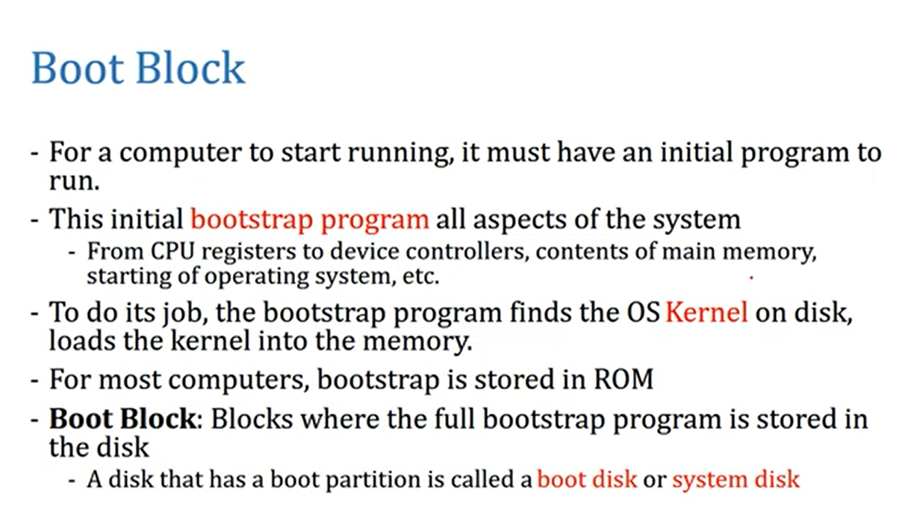

Slide 30
Boot block
The problem is that changing the bootstrap code basically requires changes in the ROM hardware chips. Because of this reason, most system nowadays has the tiny bootstrap loader program in the boot whose only job is to bring the full bootstrap program from the disk. Through this now we are able to change the full bootstrap program easily and the new version can be easily written onto the disk.
The full bootstrap program is stored in the boot blocks at a fixed location on the disk. A disk that has a boot partition is called a boot disk. The code in the boot ROM basically instructs the read controller to read the boot blocks into the memory and then starts the execution of code. The full bootstrap program is more complex than the bootstrap loader in the boot ROM,

Slide 31
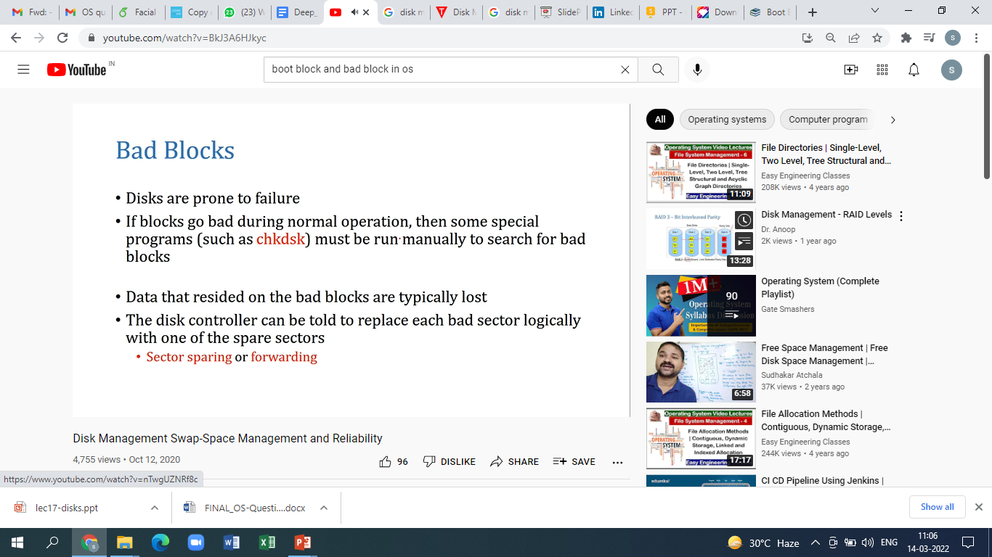

Slide 32
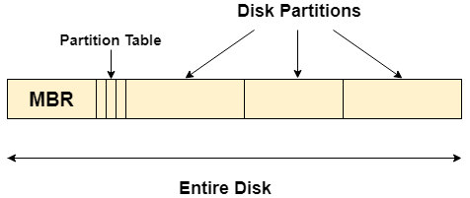
Master Boot Record (MBR)
Master boot record is the information present in the first sector of any hard disk. It contains the information regarding how and where the Operating system is located in the hard disk so that it can be booted in the RAM.
MBR is sometimes called master partition table because it includes a partition table which locates every partition in the hard disk.
Master boot record (MBR) also includes a program which reads the boot sector record of the partition that contains operating system.

Slide 33
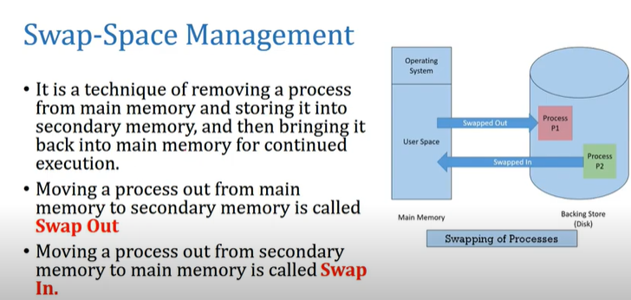

Slide 34
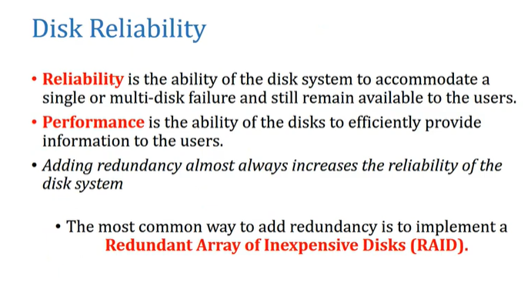

Slide 35
RAID
Redundant Array of Independent Disks
Set of physical disk drives viewed by the operating system as a single logical drive
Data are distributed across the physical drives of an array
Redundant disk capacity is used to store parity information which provides recoverability from disk failure

Slide 36
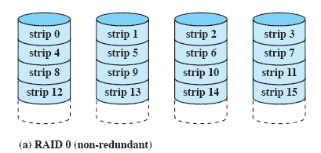
RAID 0 - Stripped
Not a true RAID – no redundancy
Disk failure is catastrophic
Very fast due to parallel read/write

Slide 37
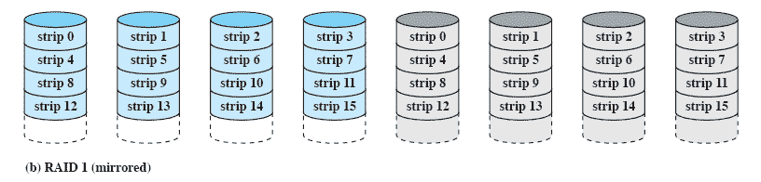
RAID 1 - Mirrored
Redundancy through duplication instead of parity.
Read requests can made in parallel.
Simple recovery from disk failure

Slide 38
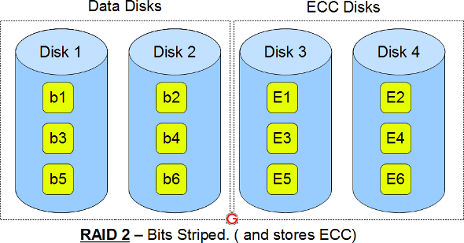
RAID 2 (Using Hamming code)
This uses bit level striping. i.e Instead of striping the blocks across the disks, it stripes the bits across the disks.
In the above diagram b1, b2, b3 are bits. E1, E2, E3 are error correction codes.
You need two groups of disks. One group of disks are used to write the data, another group is used to write the error correction codes.
This uses Hamming error correction code (ECC), and stores this information in the redundancy disks.

Slide 39
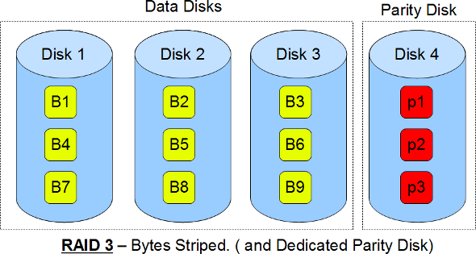
RAID 3 byte level striping
This uses byte level striping. i.e Instead of striping the blocks across the disks, it stripes the bytes across the disks.
In the above diagram B1, B2, B3 are bytes. p1, p2, p3 are parities.
Uses multiple data disks, and a dedicated disk to store parity.

Slide 40
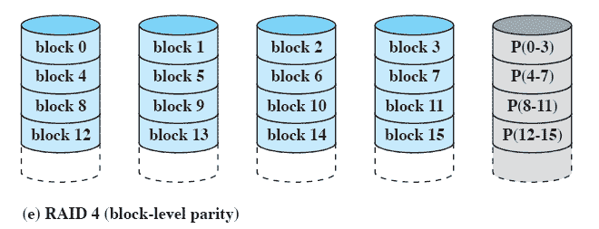
RAID 4 Block-level parity
A bit-by-bit parity strip is calculated across corresponding strips on each data disk
The parity bits are stored in the corresponding strip on the parity disk.

Slide 41
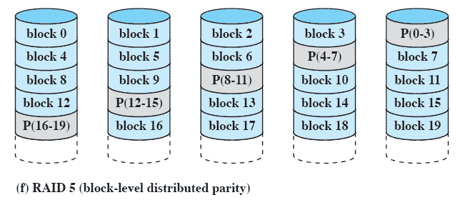
RAID 5 Block-level Distributed parity
Similar to RAID-4 but distributing the parity bits across all drives

Slide 42
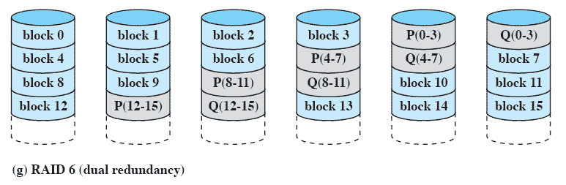
RAID 6 Dual Redundancy
Two different parity calculations are carried out
stored in separate blocks on different disks.
Can recover from two disks failing

Slide 43
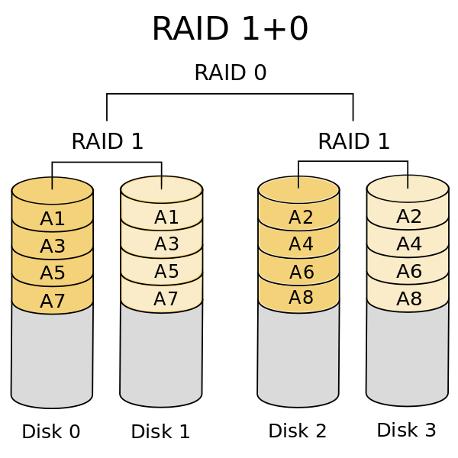
RAID 10
The redundant array of independent disks (RAID) is a way to store data across multiple hard drives in order to offer better speed or redundancy, or both. RAID 10 combines both disk mirroring (RAID 1) and disk striping (RAID 0) configurations to keep your data safer.

Slide 44
THANK YOU

